Slide 1
Basics of chest X ray
Dr Sheetu Singh
Assistant Professor
Institute of respiratory disease,
SMS Medical college, Jaipur

Slide 2
Chest X Ray
How will you evaluate a chest X ray?
Type of view
Exposure
Complete vs Incomplete film
Soft tissue
Bony structures
Trachea
Hilum
Heart
Cardiophrenic and Costophrenic angles
Lung

Slide 3
1. Type of view
PA view
AP view
Lateral view (all fissures are seen on lateral film)
Lateral decubitus
Lordotic view

Slide 4
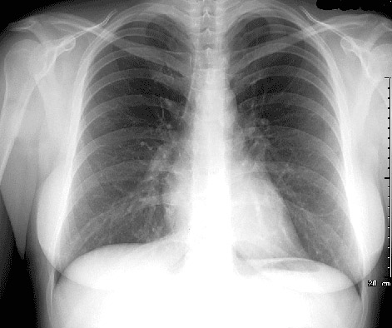
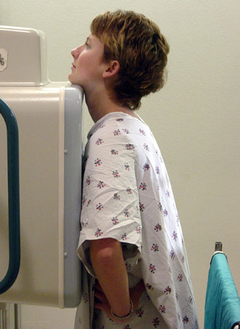
PA view
1. Type of view

Slide 5
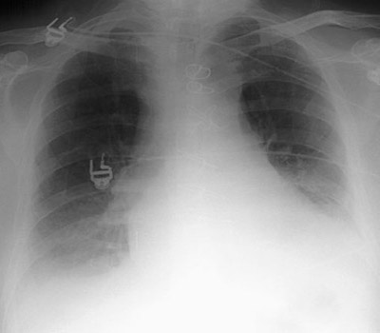
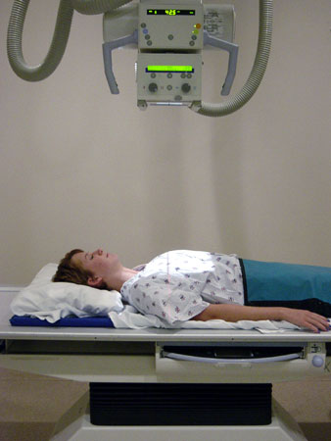
AP VIEW
1. Type of view

Slide 6
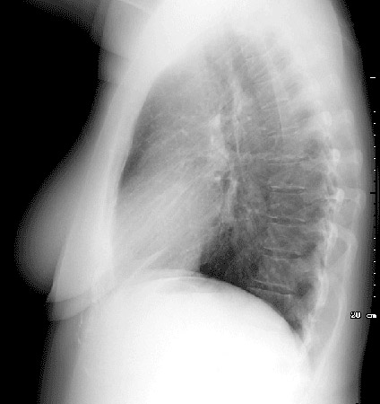
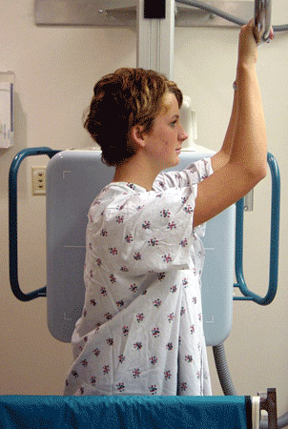
LATERAL VIEW
1. Type of view

Slide 7
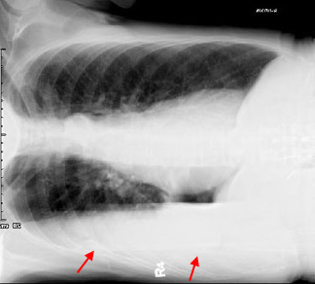
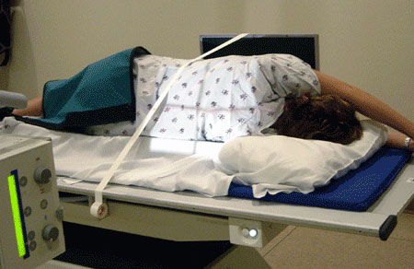
LATERAL DECUBITUS
1. Type of view

Slide 8
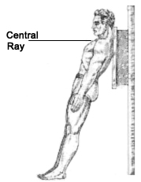
LORDOTIC VIEW
1. Type of view

Slide 9
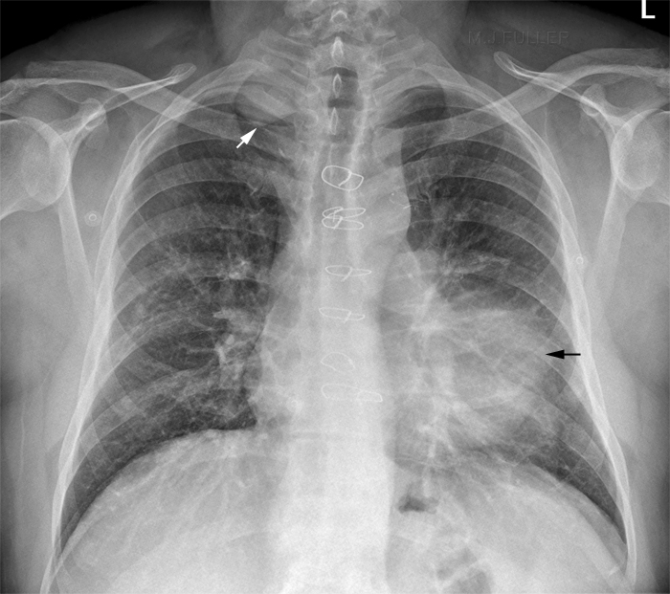
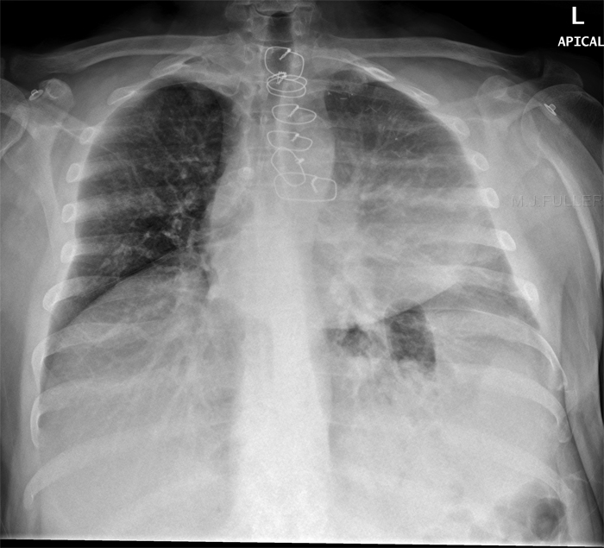
LORDOTIC VIEW
1. Type of view

Slide 10
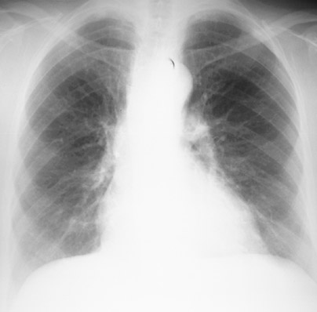
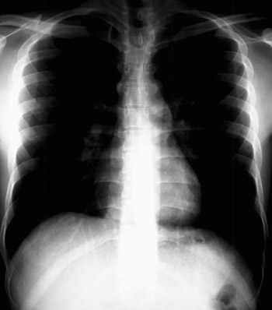
2. Exposure
Exposure made in full inspiration

Slide 11
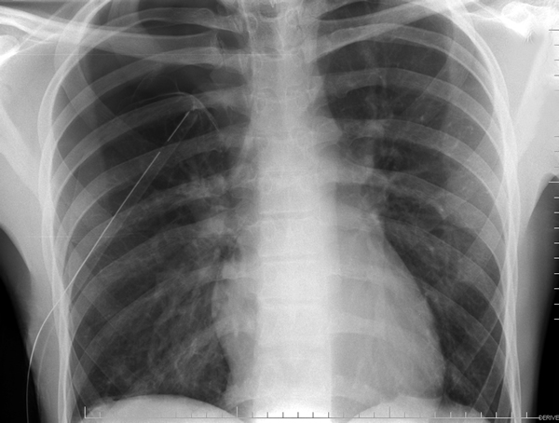
3. Complete vs Incomplete film
Despite best efforts only 60% of lungs are visualized on chest X ray as rest is hidden by other structures

Slide 12
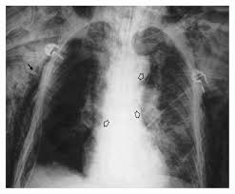
4. Soft tissue

Slide 13
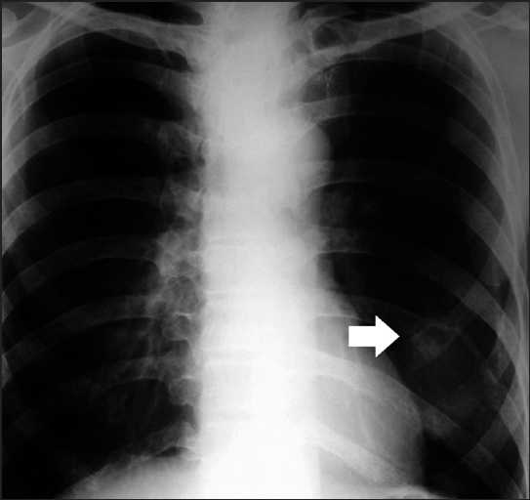
5. Bony structures

Slide 14
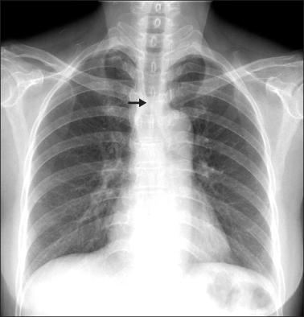
6. Trachea

Slide 15
7. Hilum
Pulmonary arteries and their main branches
Upper lobe pulmonary veins
Major bronchi
Lymph nodes
Left hilum is higher than the right hilum.

Slide 16
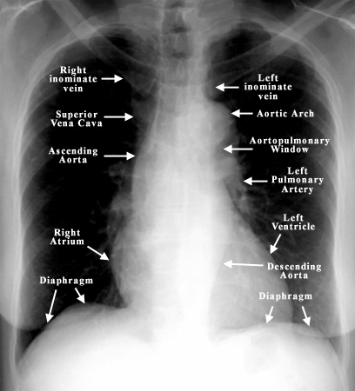
7. Hilum

Slide 17
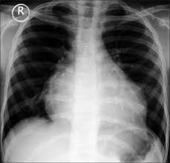
8. Heart

Slide 18
9. Diaphragm
Left diaphragm is lower than the right because heart depresses the left diaphragm

Slide 19
Cardiophrenic and Costophrenic angles

Slide 20
10. Lung

Slide 21
Solitary pulmonary nodule
10. Lung
A solitary pulmonary nodule is defined as a discrete, well-marginated, rounded opacity less than or equal to 3 cm in diameter that is completely surrounded by lung parenchyma, does not touch the hilum or mediastinum, and is not associated with adenopathy, atelectasis or pleural effusion.
Lesions larger than 3 cm are considered masses and are treated as malignancies until proven otherwise.

Slide 22
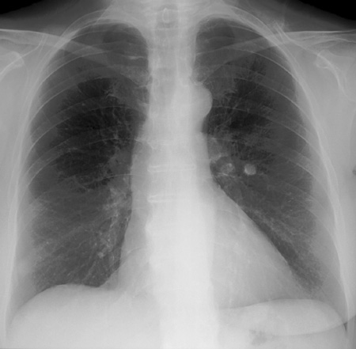
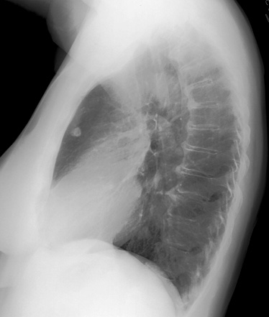
10. Lung

Slide 23
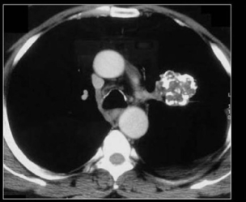
Solitary pulmonary nodule
10. Lung
Hamartoma: popcorn calcification
Non cavitating nodules
Diagnosis:
CT chest
CT guided FNAC/Biopsy

Slide 24
Miliary shadows
10. Lung
Silicosis
Coal workers pneumoconiosis
Loeffler’s syndrome
Sarcoidosis / Berryliosis
Tuberculosis/Nocardia/Brucella
Histoplasmosis
Varicella
Metastasis
Rheumatoid arthritis nodules
Wegner’s granulomatosis
Amyloidosis

Slide 25
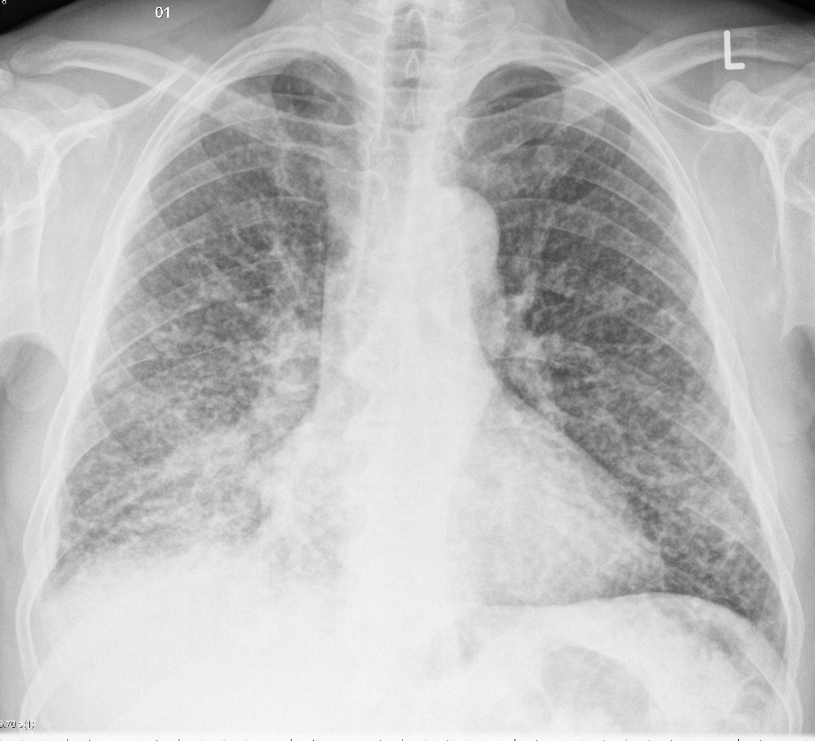
10. Lung

Slide 26
Unilateral radiolucency on chest X ray
10. Lung
Pneumothorax
Emphysema
Resection of mammary gland
Pulmonary artery obstruction
Patient rotation

Slide 27
Emphysema
10. Lung
Flattened diaphragm (terrace pattern)
Tubular heart
Increased rib spaces
Increased retrosternal air spaces

Slide 28
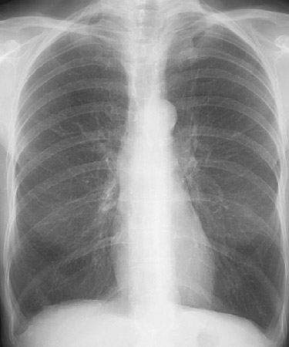
10. Lung

Slide 29
Pleural effusion
10. Lung
Obtuse angle with chest wall
Not confined to bronchopulmonary segment
Air bronchogram not visualized (seen in Consolidation)
Diagnostic modality –
I/L Lateral decubitus
USG chest
CT chest

Slide 30
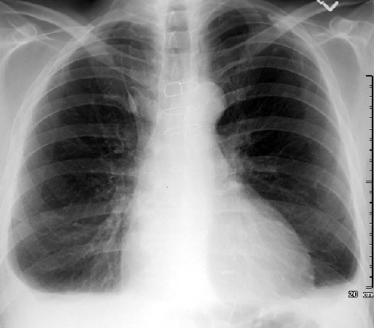
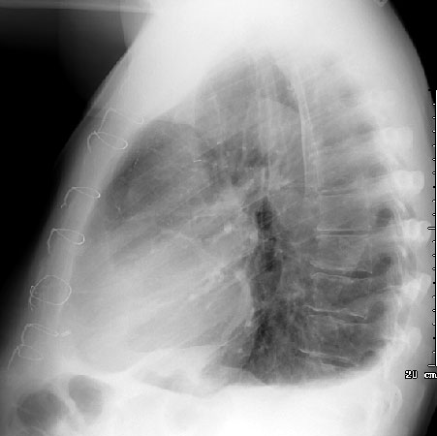
10. Lung

Slide 31
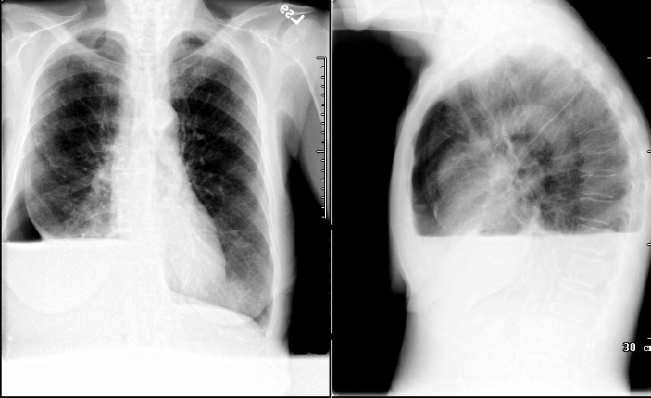
10. Lung

Slide 32
Asbestosis
10. Lung
Pleural plaques (primarily the diaphragmatic pleura)
Pulmonary fibrosis
Mesothelioma
Lung cancer

Slide 33
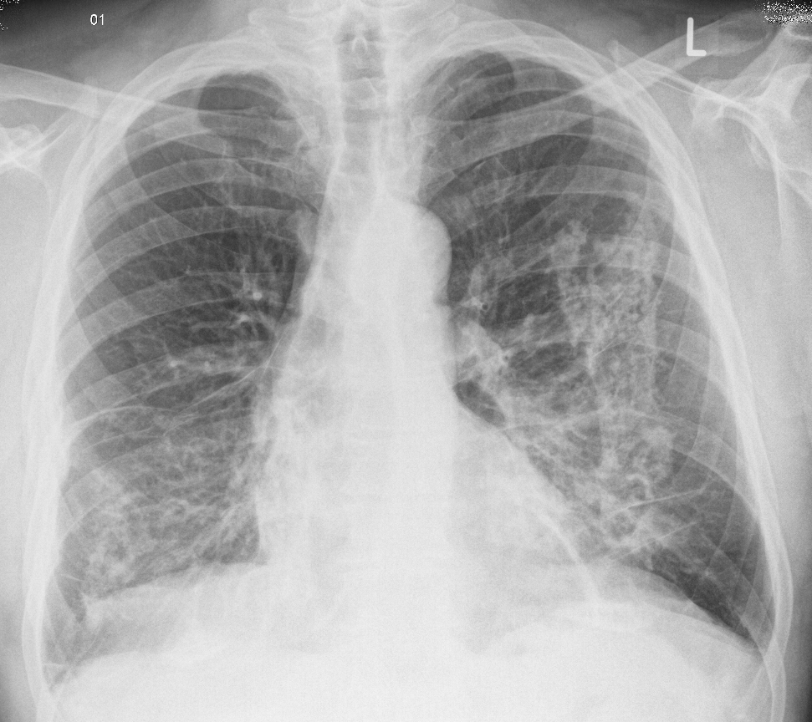
Pleural plaques
10. Lung

Slide 34
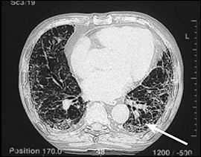
Pleural fibrosis
10. Lung

Slide 35
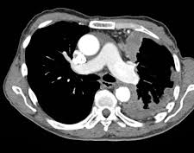
Mesothelioma
10. Lung

Slide 36
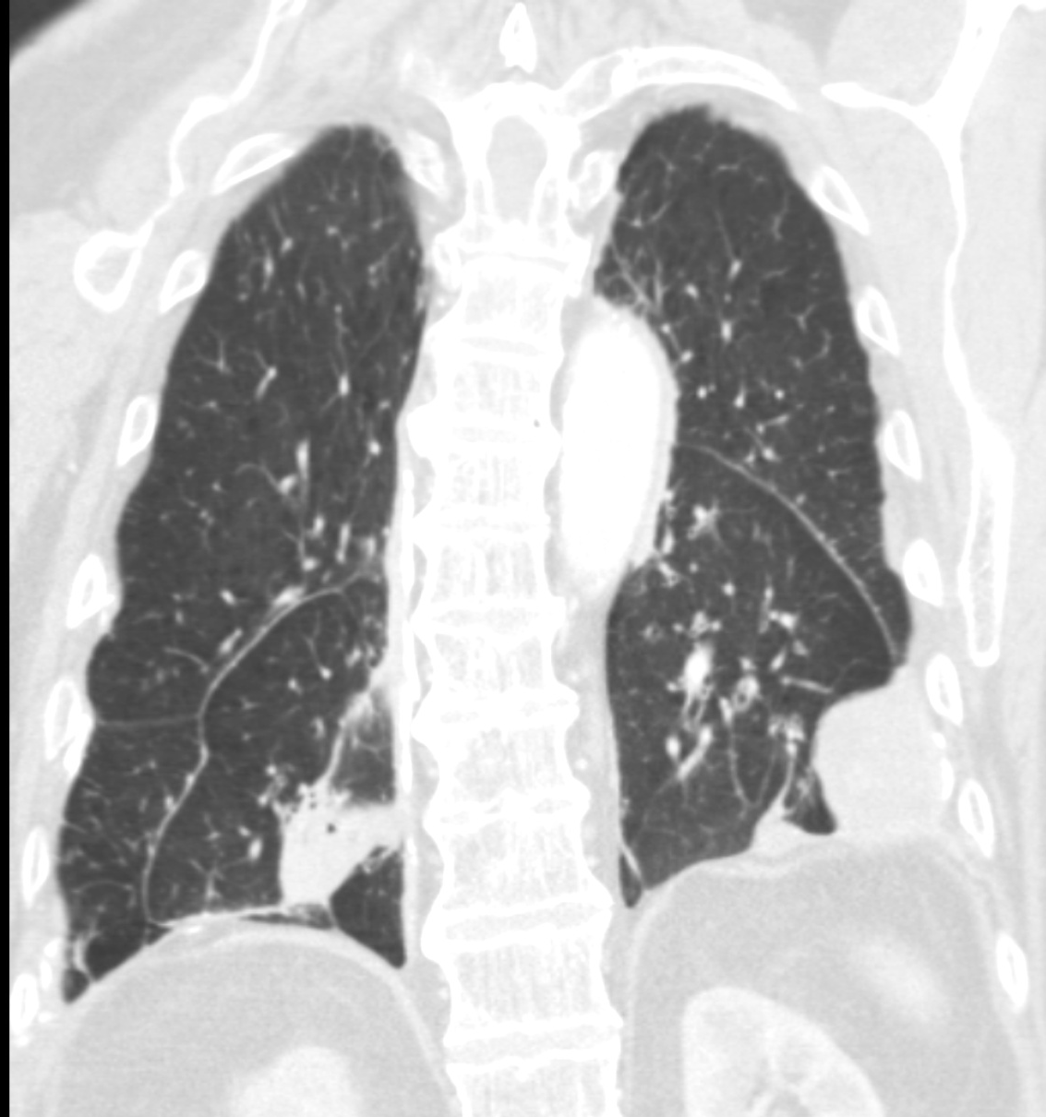
Round atelectasis – comet tail sign
10. Lung

Slide 37
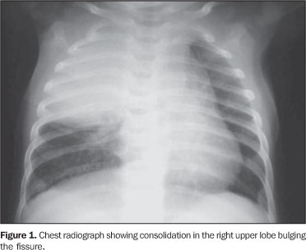
Bulging of fissure seen in -
10. Lung
Klebsiella pneumonia

Slide 38
Pneumatocele formation -
10. Lung
Staphylococcal pneumonia
PCP pneumonia

Slide 39
Pulmonary edema
10. Lung
Bat wing appearance on Chest X ray
Seen in –
Congestive cardiac failure
Uremic lung

Slide 40
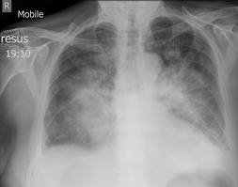
10. Lung

Slide 41
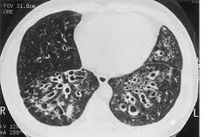
Bronchiectasis
10. Lung

Slide 42
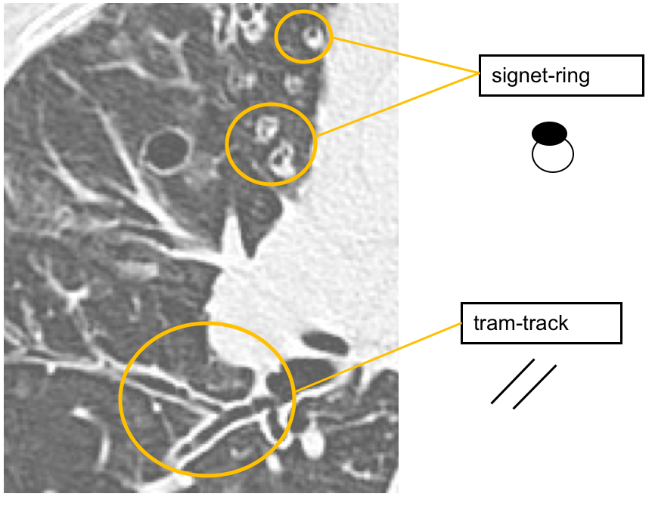
Bronchiectasis
10. Lung

Slide 43
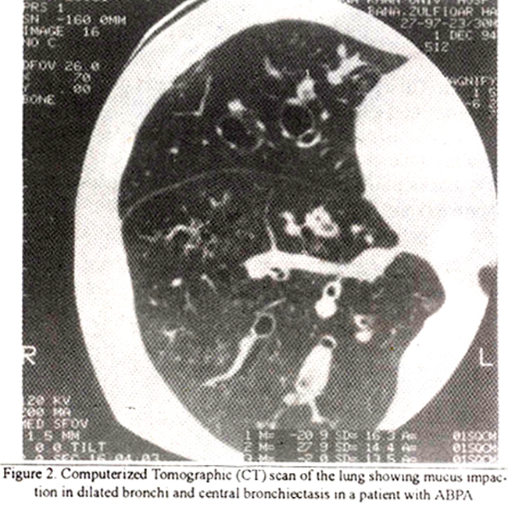
Bronchiectasis
10. Lung

Slide 44
Massive hemoptysis
10. Lung
Bronchial artery

Slide 45
Pulmonary embolism
10. Lung
Hampton’s hump
Westermark sign
Palla’s sign
Gold standard investigation
Pulmonary angiography
VQ scan – perfusion defect with normal lung scan

Slide 46
10. Lung

Slide 47
Tuberculosis
10. Lung
Upper lobe predominance
Lower lobe involvement in immunocompromised host (DM, HIV)
Cavitation, Fibrosis
Mediastinal lymph node enlargement with necrosis

Slide 48
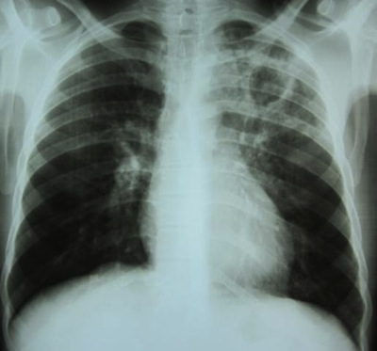
Tuberculosis
10. Lung

Slide 49
HIV
10. Lung
PCP – perihilar bat wing appearance (GGO)
AIDS defining illness
Pentamidine increases risk of pneumothorax
Tuberculosis – if CD4 count is low cavitation is less likely and chances of lymphadenopathy
Kaposi sarcoma – pulmonary, visceral and cutaneous involvement. (pleural and pericardial effusion common)

Slide 50
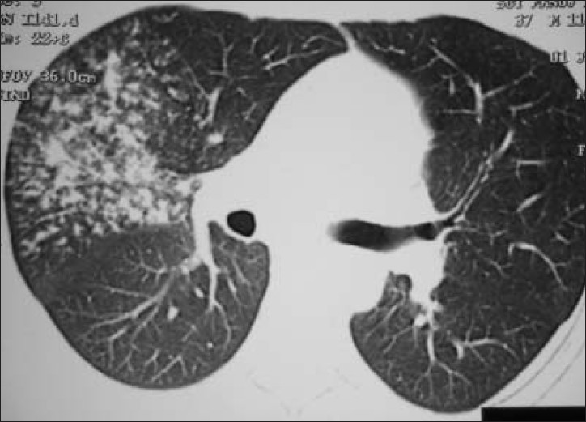
Tree in bud appearance
10. Lung

Slide 51
Tree in bud appearance
10. Lung
Infective bronchiolitis
Pulmonary tuberculosis
MAC
Viral pneumonia
Fungal infection – aspergillus
ABPA
PCP
Congenital
Cystic fibrosis
Bronchiolitis
Neoplastic
Bronchioalveolar carcinoma

Slide 52
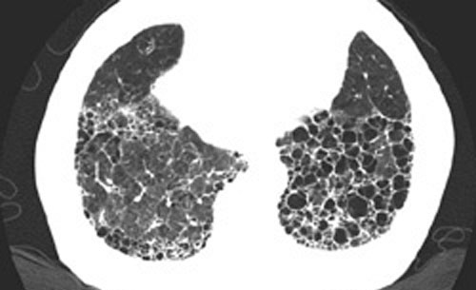
Honeycombing of lung seen in
10. Lung
Interstitial lung disease
Idiopathic
Secondary to collagen vascular diseases (like RA, Scleroderma, Sjogren’s syndrome)
Sarcoidosis

Slide 53
Computed Tomography
Tomography = sectional imaging / slice (transverse section view)
CT generates images in transaxial section (perpendicular to cranio-caudal axis)
CT measures the degree of attenuation of X ray beams by various tissues in the body → called as HOUNSEFIELD unit (Godfrey Hounsefield)
Ranges from -1000 HU (Black)→ 3000 HU (White)
Air = -1000 HU
Water = 0 HU

Slide 54
Walls of CT scan room are coated with –
Lead
Glass
Tungsten
Iron

Slide 55
Role of CT chest in hemoptysis
In a patient with hemoptysis and a normal chest X ray, the first investigation of choice
CT chest → Bronchoscopy
(this localization of the disease, improves the yield of bronchoscopy and also helpful in staging of tumor)

Slide 56
HRCT chest
Characterized by
Narrow beam collimation
High spatial reconstruction algorithm / Bone algorithm
Small field of view
HRCT chest used to diagnose –
Interstitial lung disease (ILD)
Bronchiectasis

